Slide 1
Psychometrics:
Reliability and Validity

Slide 2
Outline
Reliability
Internal Consistency
Test-retest
Inter-rater
Validity
Construct
Content
Concurrent
Convergent
Divergent
Predictive
Goals
Define reliability and validity.
Differentiate reliability and validity.
Provide specific examples of violations and confirmations of different types of reliability and validity.

Slide 3
How do we know if what we’re studying is really what we think we’re studying?
Reliability & Validity

Slide 4
Reliability
Reliability helps us figure out if our measure is consistent or stable
Measured Score = True score + Error
Reliable measures have low measurement error
Reliable: Measured Score = True score + Error
Unreliable: Measured Score = True score + Error

Slide 5
Validity
Validity helps us figure out if we’re actually studying what we intend to study

Slide 6
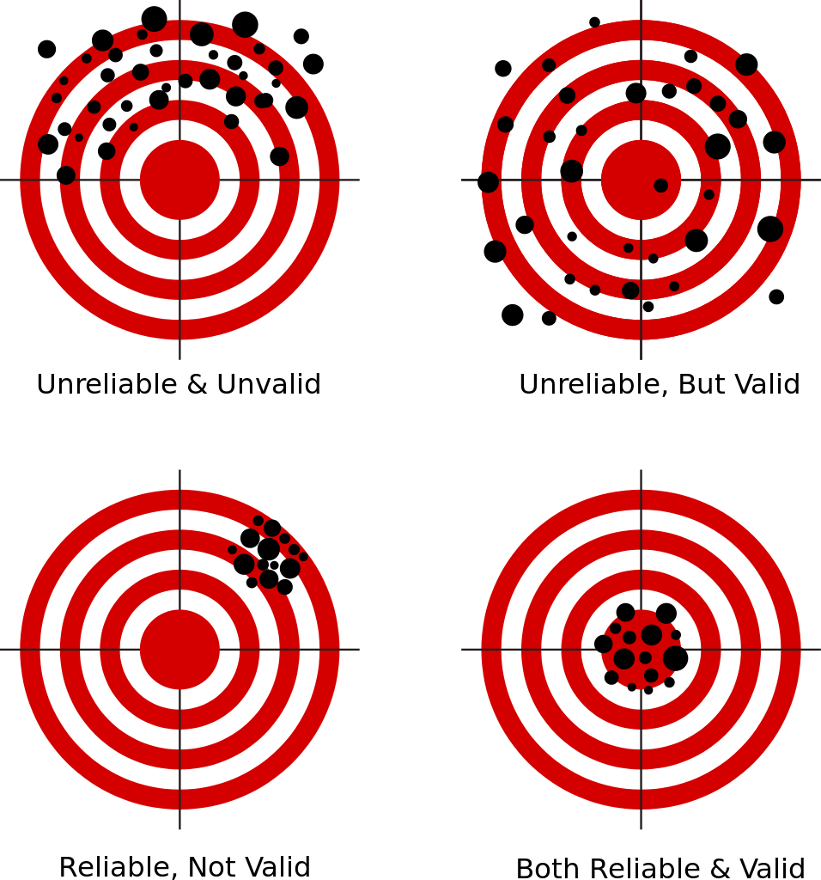
Psychometric Intersection
•
•
•
•
•
•
•
•
•
•
•
•
•
•
•
•
•
•
https://goo.gl/images/KeDm1R

Slide 7
Reliability

Slide 8
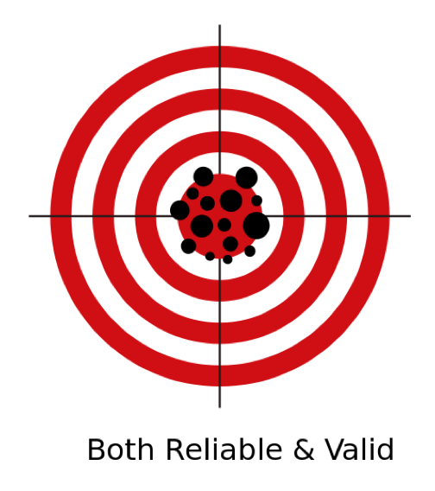
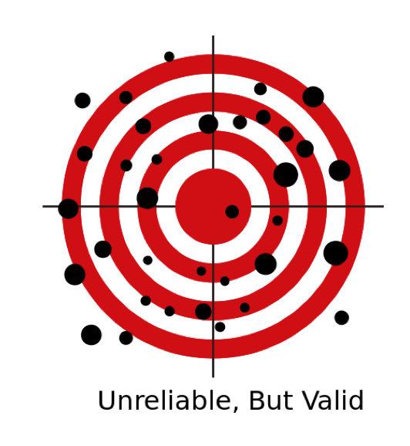
Types of Reliability
Internal Consistency
Item Total Correlations
Split-Half Reliability
Cronbach’s Alpha
Reliability Across Time
Test-retest and alternate form
Reliability Across People
Inter-rater Agreement
•
•
•
•
•
•
•
•
•

Slide 9
Reliability at one time-point
Internal consistency: How do the individual items relate to one another?
Item-total correlations
Split-half reliability
Cronbach’s alpha: Theoretical extension
Measured Score = True score + Error
Measured Score = True score + Error
Unreliable
Reliable
Notes:
Inter-item correlations: Correlation of each item on the measure with every other item on the measure
Cronbach’s alpha: theoretical extension of inter-item correlations. If we looked at these items with all theoretical possible sample sizes…
Item-total correaltions: Correlation of each item on the measure with the total score on the measure

Slide 10
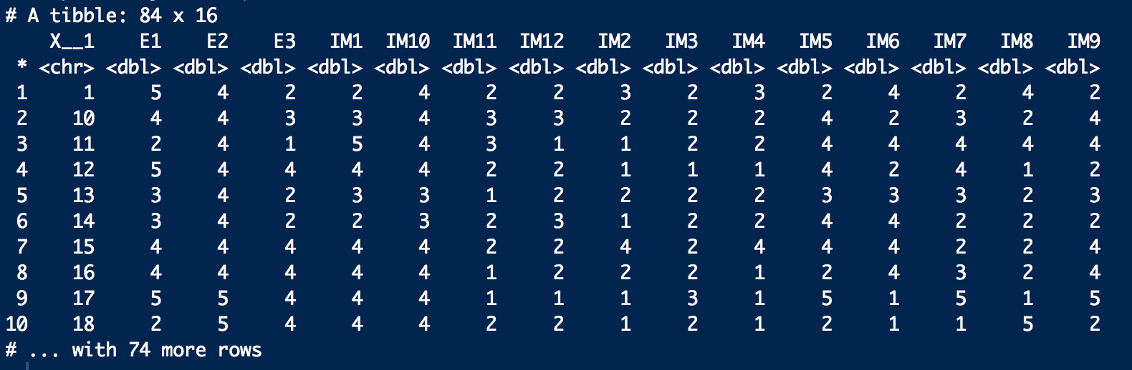
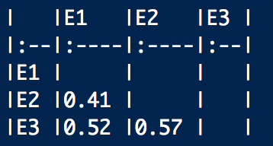
Inter Item Correlations
Inter = between
Item = items in a survey
Inter item = correlations between items
BFI-S Extraversion:
I am communicative.
I am sociable.
I am reserved. (-)
r = .52
r = .41
r = .57

Slide 11
Inter Item Correlations
Inter = between
Item = items in a survey
Inter item = correlations between items
Extraversion
Imitation

Slide 12
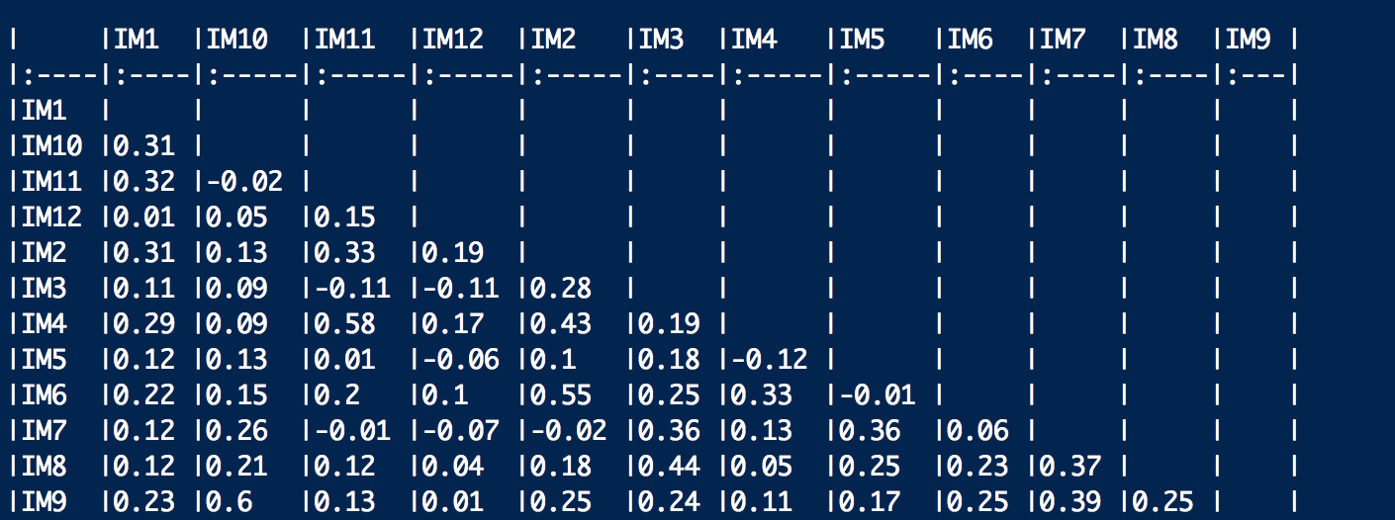
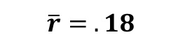
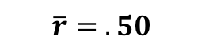
Inter Item Correlations
Inter = between
Item = items in a survey
Inter item = correlations between items
Extraversion
Imitation
$$\overline{r}= .50$$
$$\overline{r}= .18$$

Slide 13
Item Total Correlations
Item = items in the scale
Total = average score on the rest of the scale (not including the item of interest)
Item Total Correlations = how well a specific item tracks responses to the rest of the scale
Extraversion | r
I am communicative. | .53
I am sociable. | .57
I am reserved. (-) | .65
$$\overline{r}= .58$$
All other items
1 Item
Notes:
Add animations
Reformat such that there are rows for the items (with the full item text)
When you show that there are the items that are or are not as related
Doing this kind of analysis can help us refine our measurements and hone in on our target to create more reliable and valid measures

Slide 14
Item Total Correlations
Item = items in the scale
Total = average score on the rest of the scale (not including the item of interest)
Item Total Correlations = how well a specific item tracks responses to the rest of the scale
Imitation
 | r
1. Goes along with other people’s decision | .40
2. Tends to follow current fashion trends? | .35
3. Follows all the current celebrity news | .31
4. Rarely follow celebrity gossip | .09
5. Tries to match their interests with their friends | .51
6. Tries to emulate my role models in my behaviors | .36
 | r
7. Prefers to do things that are original (reverse coded, catch yay/nay-sayers) | .42
8. Often compares him/herself to his/her role model | .20
9. Is indifferent when people speak poorly of people I admire (reverse coded) | .43
10. Enjoys having memorabilia (e.g. stickers, photos, jerseys, shirts) of my role models | .34
11. Describes myself in terms that also describe my role model | .40
12. Emulates the people I admire. | .48
Notes:
Add animations
Reformat such that there are rows for the items (with the full item text)
When you show that there are the items that are or are not as related
Doing this kind of analysis can help us refine our measurements and hone in on our target to create more reliable and valid measures

Slide 15
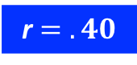
Item Total Correlations
Item = items in the scale
Total = average score on the rest of the scale (not including the item of interest)
Item Total Correlations = how well a specific item tracks responses to the rest of the scale
r $= .40$
Item
Total
X__1 | IM1 | IM2 | IM3 | IM4 | IM5 | IM6 | IM7 | IM8 | IM9 | IM10 | IM11 | IM12 | Item | M_{Total}
1 | 2 | 3 | 2 | 3 | 2 | 4 | 2 | 4 | 2 | 4 | 2 | 2 | 2 | 2.73
10 | 3 | 2 | 2 | 2 | 4 | 2 | 3 | 2 | 4 | 4 | 3 | 3 | 3 | 2.82
11 | 5 | 1 | 2 | 2 | 4 | 4 | 4 | 4 | 4 | 4 | 3 | 1 | 5 | 3.00
12 | 4 | 1 | 1 | 1 | 4 | 2 | 4 | 1 | 2 | 4 | 2 | 2 | 4 | 2.18
13 | 3 | 2 | 2 | 2 | 3 | 3 | 3 | 2 | 3 | 3 | 1 | 2 | 3 | 2.36
14 | 2 | 1 | 2 | 2 | 4 | 4 | 2 | 2 | 2 | 3 | 2 | 3 | 2 | 2.45
15 | 4 | 4 | 2 | 4 | 4 | 4 | 2 | 2 | 4 | 4 | 2 | 2 | 4 | 3.09
16 | 4 | 2 | 2 | 1 | 2 | 4 | 3 | 2 | 4 | 4 | 1 | 2 | 4 | 2.45
17 | 4 | 1 | 3 | 1 | 5 | 1 | 5 | 1 | 5 | 4 | 1 | 1 | 4 | 2.55
18 | 4 | 1 | 2 | 1 | 2 | 1 | 1 | 5 | 2 | 4 | 2 | 2 | 4 | 2.09
Notes:
Add animations
Reformat such that there are rows for the items (with the full item text)
When you show that there are the items that are or are not as related
Doing this kind of analysis can help us refine our measurements and hone in on our target to create more reliable and valid measures

Slide 16
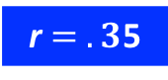
Item Total Correlations
Item = items in the scale
Total = average score on the rest of the scale (not including the item of interest)
Item Total Correlations = how well a specific item tracks responses to the rest of the scale
Total
r $= .3$5
Item
X__1 | IM1 | IM2 | IM3 | IM4 | IM5 | IM6 | IM7 | IM8 | IM9 | IM10 | IM11 | IM12 | Item | M_{total}
1 | 2 | 3 | 2 | 3 | 2 | 4 | 2 | 4 | 2 | 4 | 2 | 2 | 3 | 2.64
10 | 3 | 2 | 2 | 2 | 4 | 2 | 3 | 2 | 4 | 4 | 3 | 3 | 2 | 2.91
11 | 5 | 1 | 2 | 2 | 4 | 4 | 4 | 4 | 4 | 4 | 3 | 1 | 1 | 3.36
12 | 4 | 1 | 1 | 1 | 4 | 2 | 4 | 1 | 2 | 4 | 2 | 2 | 1 | 2.45
13 | 3 | 2 | 2 | 2 | 3 | 3 | 3 | 2 | 3 | 3 | 1 | 2 | 2 | 2.45
14 | 2 | 1 | 2 | 2 | 4 | 4 | 2 | 2 | 2 | 3 | 2 | 3 | 1 | 2.55
15 | 4 | 4 | 2 | 4 | 4 | 4 | 2 | 2 | 4 | 4 | 2 | 2 | 4 | 3.09
16 | 4 | 2 | 2 | 1 | 2 | 4 | 3 | 2 | 4 | 4 | 1 | 2 | 2 | 2.64
17 | 4 | 1 | 3 | 1 | 5 | 1 | 5 | 1 | 5 | 4 | 1 | 1 | 1 | 2.82
18 | 4 | 1 | 2 | 1 | 2 | 1 | 1 | 5 | 2 | 4 | 2 | 2 | 1 | 2.36
Notes:
Add animations
Reformat such that there are rows for the items (with the full item text)
When you show that there are the items that are or are not as related
Doing this kind of analysis can help us refine our measurements and hone in on our target to create more reliable and valid measures

Slide 17
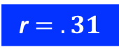
Item Total Correlations
Item = items in the scale
Total = average score on the rest of the scale (not including the item of interest)
Item Total Correlations = how well a specific item tracks responses to the rest of the scale
Total
r $= .31$
Item
X__1 | IM1 | IM2 | IM3 | IM4 | IM5 | IM6 | IM7 | IM8 | IM9 | IM10 | IM11 | IM12 | Item | M_{total}
1 | 2 | 3 | 2 | 3 | 2 | 4 | 2 | 4 | 2 | 4 | 2 | 2 | 2 | 2.73
10 | 3 | 2 | 2 | 2 | 4 | 2 | 3 | 2 | 4 | 4 | 3 | 3 | 2 | 2.91
11 | 5 | 1 | 2 | 2 | 4 | 4 | 4 | 4 | 4 | 4 | 3 | 1 | 2 | 3.27
12 | 4 | 1 | 1 | 1 | 4 | 2 | 4 | 1 | 2 | 4 | 2 | 2 | 1 | 2.45
13 | 3 | 2 | 2 | 2 | 3 | 3 | 3 | 2 | 3 | 3 | 1 | 2 | 2 | 2.45
14 | 2 | 1 | 2 | 2 | 4 | 4 | 2 | 2 | 2 | 3 | 2 | 3 | 2 | 2.45
15 | 4 | 4 | 2 | 4 | 4 | 4 | 2 | 2 | 4 | 4 | 2 | 2 | 2 | 3.27
16 | 4 | 2 | 2 | 1 | 2 | 4 | 3 | 2 | 4 | 4 | 1 | 2 | 2 | 2.64
17 | 4 | 1 | 3 | 1 | 5 | 1 | 5 | 1 | 5 | 4 | 1 | 1 | 3 | 2.64
18 | 4 | 1 | 2 | 1 | 2 | 1 | 1 | 5 | 2 | 4 | 2 | 2 | 2 | 2.27
Notes:
Add animations
Reformat such that there are rows for the items (with the full item text)
When you show that there are the items that are or are not as related
Doing this kind of analysis can help us refine our measurements and hone in on our target to create more reliable and valid measures

Slide 18
Item Total Correlations
Item = items in the scale
Total = average score on the rest of the scale (not including the item of interest)
Item Total Correlations = how well a specific item tracks responses to the rest of the scale
$$\overline{r}= .36$$
Imitation
 | r
1. Goes along with other people’s decision | .40
2. Tends to follow current fashion trends? | .35
3. Follows all the current celebrity news | .31
4. Rarely follow celebrity gossip | .09
5. Tries to match their interests with their friends | .51
6. Tries to emulate my role models in my behaviors | .36
 | r
7. Prefers to do things that are original (reverse coded, catch yay/nay-sayers) | .42
8. Often compares him/herself to his/her role model | .20
9. Is indifferent when people speak poorly of people I admire (reverse coded) | .43
10. Enjoys having memorabilia (e.g. stickers, photos, jerseys, shirts) of my role models | .34
11. Describes myself in terms that also describe my role model | .40
12. Emulates the people I admire. | .48
All other items
1 Item
Notes:
Add animations
Reformat such that there are rows for the items (with the full item text)
When you show that there are the items that are or are not as related
Doing this kind of analysis can help us refine our measurements and hone in on our target to create more reliable and valid measures

Slide 19
Now you try!
Open up the “Survey+Personality.csv” file in JASP
Are there any items with lower item-total (rest) correlations than you’d expect?
What do items with high item-total correlations mean for your scale reliability? What about items with low item-total correlations?

Slide 20
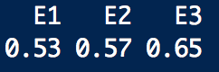
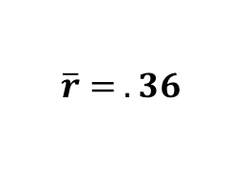
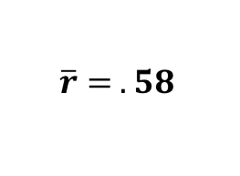
Item Total Correlations
Item = items in the scale
Total = average score on the rest of the scale (not including the item of interest)
Item Total Correlations = how well a specific item tracks responses to the rest of the scale
Extraversion
Imitation
$$\overline{r}= .58$$
$$\overline{r}= .36$$
All other items
All other items
1 Item
1 Item
Notes:
Add animations
Reformat such that there are rows for the items (with the full item text)
When you show that there are the items that are or are not as related
Doing this kind of analysis can help us refine our measurements and hone in on our target to create more reliable and valid measures

Slide 21
Split Half Correlations
Anyone see a problem with this?
Split-half: split your data in half
Split-half correlation: correlation between halves
r(82) = .58
Half 1
Half 2
M_{h1}
M_{h2}
X__1 | IM1 | IM2 | IM3 | IM4 | IM5 | IM6 | IM7 | IM8 | IM9 | IM10 | IM11 | IM12 | h1 | h2
1 | 2 | 3 | 2 | 3 | 2 | 4 | 2 | 4 | 2 | 4 | 2 | 2 | 2.67 | 2.67
10 | 3 | 2 | 2 | 2 | 4 | 2 | 3 | 2 | 4 | 4 | 3 | 3 | 2.5 | 3.17
11 | 5 | 1 | 2 | 2 | 4 | 4 | 4 | 4 | 4 | 4 | 3 | 1 | 3 | 3.33
12 | 4 | 1 | 1 | 1 | 4 | 2 | 4 | 1 | 2 | 4 | 2 | 2 | 2.17 | 2.5
13 | 3 | 2 | 2 | 2 | 3 | 3 | 3 | 2 | 3 | 3 | 1 | 2 | 2.5 | 2.33
14 | 2 | 1 | 2 | 2 | 4 | 4 | 2 | 2 | 2 | 3 | 2 | 3 | 2.5 | 2.33
15 | 4 | 4 | 2 | 4 | 4 | 4 | 2 | 2 | 4 | 4 | 2 | 2 | 3.67 | 2.67
16 | 4 | 2 | 2 | 1 | 2 | 4 | 3 | 2 | 4 | 4 | 1 | 2 | 2.5 | 2.67
17 | 4 | 1 | 3 | 1 | 5 | 1 | 5 | 1 | 5 | 4 | 1 | 1 | 2.5 | 2.83
18 | 4 | 1 | 2 | 1 | 2 | 1 | 1 | 5 | 2 | 4 | 2 | 2 | 1.83 | 2.67

Slide 22
Split Half Correlations
Split-half: split your data in half
Split-half correlation: correlation between halves
r(82) = .44
M_{h1}
M_{h2}
X__1 | IM1 | IM2 | IM3 | IM4 | IM5 | IM6 | IM7 | IM8 | IM9 | IM10 | IM11 | IM12 | h1 | h2
1 | 2 | 3 | 2 | 3 | 2 | 4 | 2 | 4 | 2 | 4 | 2 | 2 | 2 | 3.33
10 | 3 | 2 | 2 | 2 | 4 | 2 | 3 | 2 | 4 | 4 | 3 | 3 | 3.17 | 2.5
11 | 5 | 1 | 2 | 2 | 4 | 4 | 4 | 4 | 4 | 4 | 3 | 1 | 3.67 | 2.67
12 | 4 | 1 | 1 | 1 | 4 | 2 | 4 | 1 | 2 | 4 | 2 | 2 | 2.83 | 1.83
13 | 3 | 2 | 2 | 2 | 3 | 3 | 3 | 2 | 3 | 3 | 1 | 2 | 2.5 | 2.33
14 | 2 | 1 | 2 | 2 | 4 | 4 | 2 | 2 | 2 | 3 | 2 | 3 | 2.33 | 2.5
15 | 4 | 4 | 2 | 4 | 4 | 4 | 2 | 2 | 4 | 4 | 2 | 2 | 3 | 3.33
16 | 4 | 2 | 2 | 1 | 2 | 4 | 3 | 2 | 4 | 4 | 1 | 2 | 2.67 | 2.5
17 | 4 | 1 | 3 | 1 | 5 | 1 | 5 | 1 | 5 | 4 | 1 | 1 | 3.83 | 1.5
18 | 4 | 1 | 2 | 1 | 2 | 1 | 1 | 5 | 2 | 4 | 2 | 2 | 2.17 | 2.33

Slide 23
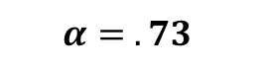
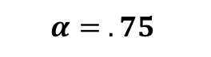
Cronbach’s Alpha
Anyone see a problem with this?
An elegant statistic solution to estimating reliability across an infinite number of sets
Rule of thumb: alpha > .8
Let’s go to JASP and see if we can find out
Extraversion
Imitation
$$α= .75$$
$$α= .73$$
3 items
12 items

Slide 24
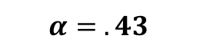
Cronbach’s Alpha
An elegant statistic solution to estimating reliability across an infinite number of sets
BUT Cronbach’s alpha can be bought!
Extraversion
Imitation
$$α= .75$$
$$α= .43$$
3 items
3 items
Reliable
Unreliable
Notes:
Show other items from the scale and show they don’t match up perfectly but close enough
Look at all possible combinations of 3 and take the average of alpha
Adjust the visualization / play with it
.87 for the 12 (60) item version of BFI

Slide 25
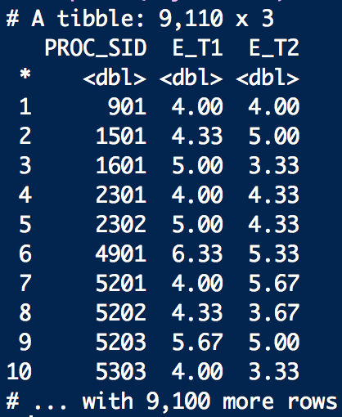
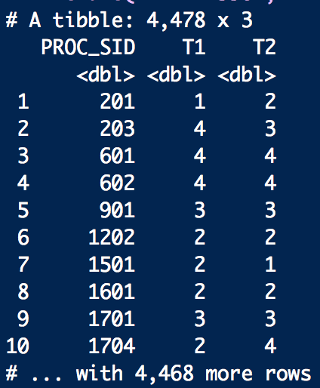
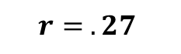
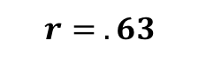
Reliability across time
Test-retest reliability: How well does one person agree with him/herself at multiple time points.
Alternate forms reliability: Examine the correlations between the multiple measures of the same construct.
Extraversion
Closeness to Family
$$r= .63$$
$$r= .27$$
Notes:
Test-retest reliability: Does the measure yield similar scores when administered on two occasions?
Alternate forms reliability: Do two forms of the same measure yield similar scores?
Change these to Extraversion composites rather than item level
----- Meeting Notes (11/6/17 00:28) -----
Alternate forms reliability: Use three items to measure Extraversion once, then use three different items to measure Extraversion on a separate occasion.

Slide 26
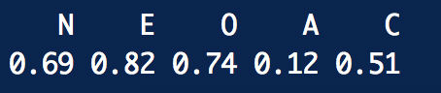
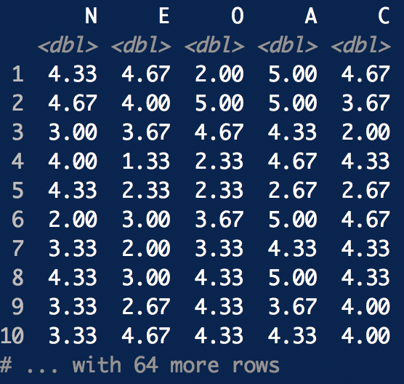
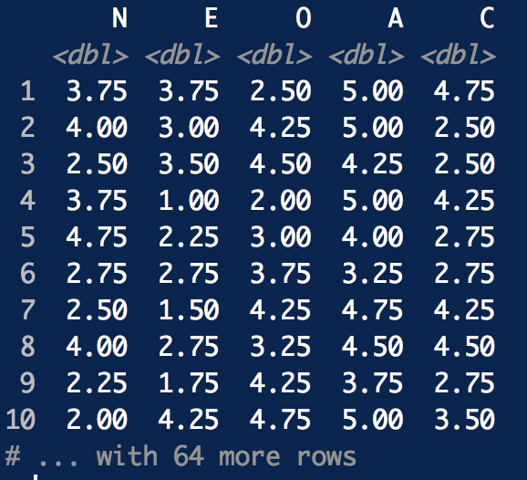
Reliability across time
Test-retest reliability: How well does one person agree with him/herself at multiple time points.
Alternate forms reliability: Examine the correlations between the multiple measures of the same construct.
BFI-S
Mini IPIP
Notes:
Test-retest reliability: Does the measure yield similar scores when administered on two occasions?
Alternate forms reliability: Do two forms of the same measure yield similar scores?
Change these to Extraversion composites rather than item level
----- Meeting Notes (11/6/17 00:28) -----
Alternate forms reliability: Use three items to measure Extraversion once, then use three different items to measure Extraversion on a separate occasion.

Slide 27
Now you try!
Back to JASP!
This time open up the file called “BFI+IPIP.csv” in JASP.
Were you able to replicate the correlations for the previous slide?
Why do you think some traits showed better alternate forms reliability than others?

Slide 28
Reliability across people
Inter-rater reliability: How well do multiple individuals agree in their observations of the same thing?
Think back to your observation activity in class…
Cohen’s kappa
George
Dora
E | A | C | N | O
4 | 3 | 3 | 2 | 2
3 | 2 | 4 | 1 | 1
2 | 1 | 4 | 3 | 1
4 | 4 | 6 | 3 | 3
2 | 5 | 2 | 1 | 3
4 | 5 | 2 | 3 | 2
… | … | … | … | …
E | A | C | N | O
4 | 1 | 3 | 2 | 2
2 | 5 | 4 | 1 | 2
2 | 5 | 3 | 3 | 1
4 | 2 | 6 | 2 | 3
3 | 2 | 2 | 1 | 3
4 | 3 | 2 | 3 | 2
… | … | … | … | …
Notes:
Inter-rater reliability: Do multiple raters agree in their observations of the same thing?
Make sure to note that these are observers making observations rather than people who are filling out a scale
Tie back to the final projects – some people are going have to code the participants’ responses. You’ll want to know that you are consistent in doing this.

Slide 29
Interim Summary
Internal Consistency: reliability of items across people
Test-retest Reliability: reliability of scales over time
Inter-rater Reliability: reliability of ratings across raters
Reliable
Unreliable

Slide 30
Validity

Slide 31
Validity
What are we measuring?
Face Validity
Content Validity
Concurrent Validity
Relationship with other measures
Convergent Validity
Divergent Validity
Predictive Validity

Slide 32
What are we measuring?
Face validity
Content validity
Concurrent validity

Slide 33
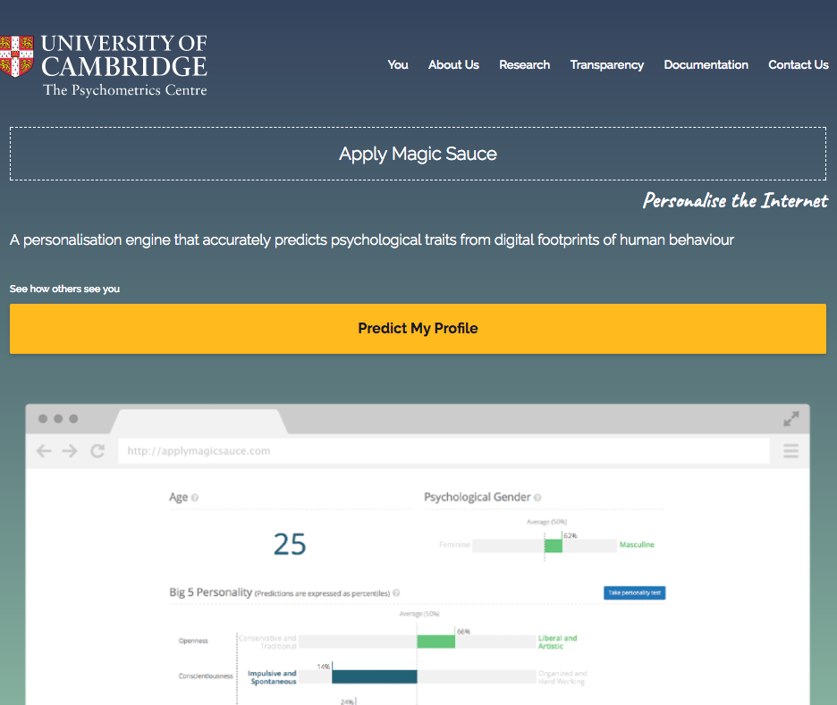
What are we measuring?
Face validity
The content of the measure appears to reflect the construct being measured
“I am sociable” or “I am friendly” to measure extraversion
High IQ
The Godfather
Mozart
Thunderstorms
The Colbert Report
Morgan Freemans Voice
The Daily Show
Lord Of The Rings
To Kill A Mockingbird
Science
Curly Fries
Low IQ
Jason Aldean
Harley Davidson
Sephora
Chiq
Bret Michaels
Clark Griswold
Bebe
I love being a mom
Lady Antebellum Low
Tyler Perry
BFI-S Extraversion:
I am communicative.
I am sociable.
I am reserved. (-)
Kosinski et al., 2013

Slide 34
What are we measuring?
Face validity
The content of the measure appears to reflect the construct being measured
“I am sociable” or “I am friendly” to measure extraversion
Content validity
The content of the measure is linked to the universe of content that defines the construct
If we adopt a biopsychosocial model of depression then our measure should include items that tap into this model

Slide 35
What are we measuring?
Content validity
The content of the measure is linked to the universe of content that defines the construct
If we think adopt a biopsychosocial model of depression then our measure should include items that tap into this model
Full Sampling Space
x
x
x
x
•
•
x
x
x
x
x
•
•
x
x
x
x
•
•
•
x
•
x
•
Bio
•
•
•
•
x
x
x
•
•
x
x
x
x
x
•
•
•
x
x
•
•
x
x
•
•
•
x
x
•
•
•
Social
Psycho
x
x
x
•
•
x
x
•
•
•
x
x
x
•
•
x
x
x
x
•
•
•
x
•
•
x
•

Slide 36
What are we measuring?
Face validity
The content of the measure appears to reflect the construct being measured
“I feel sad” or “I feel down” to measure depression
Content validity
The content of the measure is linked to the universe of content that defines the construct
If we think adopt a biopsychosocial model of depression then our measure should include items that tap into this model
Concurrent validity
Tells us if the measure differentiates people who are theoretically supposed to be different

Slide 37
What are we measuring?
Concurrent validity
Tells us if the measure differentiates people who are theoretically supposed to be different
>
CES-D-R 10 Depression
Depressed
Not Depressed
I was bothered by things that usually don't bother me.
I had trouble keeping my mind on what I was doing.
I felt depressed.
I felt that everything I did was an effort.
I felt hopeful about the future.
I felt fearful.
My sleep was restless.
I was happy.
I felt lonely.
I could not "get going."
SID | Score
1 | 22
2 | 27
3 | 23
4 | 23
5 | 22
6 | 21
7 | 20
8 | 25
9 | 28
10 | 24
M | 23.75
SID | Score
1 | 10
2 | 5
3 | 8
4 | 12
5 | 18
6 | 13
7 | 2
8 | 3
9 | 7
10 | 11
M | 7.40

Slide 38
Relationship with other measures
Convergent validity
Our measure should be related to other measures that assess a similar construct
Scores from multiple personality scales should be related
BFI-S Conscientiousness:
I am a thorough worker.
I tend to be lazy (-)
I carry out tasks efficiently
BFI Conscientiousness
NEO-FFI Conscientiousness
BFI-S
Conscientiousness
Mini IPIP Conscientiousness
Mini IPIP Conscientiousness:
I get chores done right away.
I like order
Often forget to put things back in their proper place (-)
I make a mess of things (-)
Notes:
Can be inter-scale (across subscales) or across measures assessing a similar construct
Show other items from the scale and show they don’t match up perfectly but close enough

Slide 39
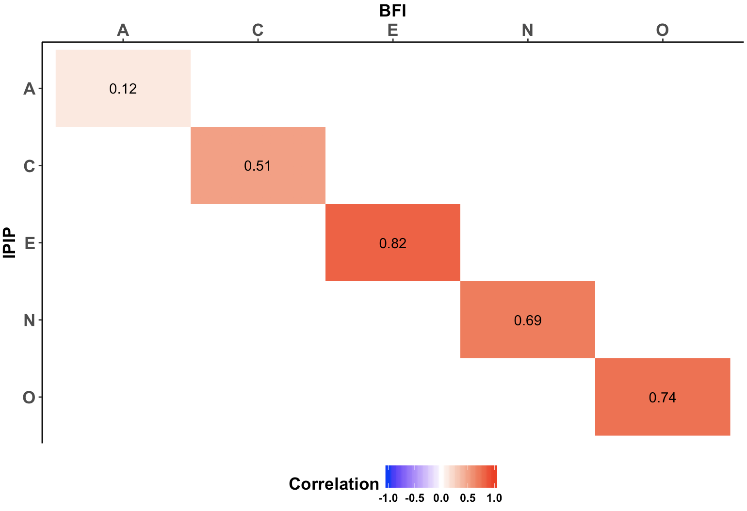
Relationship with other measures
Convergent validity
Our measure should be related to other measures that assess a similar construct
Scores from multiple personality scales should be related
BFI Conscientiousness
Mini IPIP Conscientiousness
Notes:
Can be inter-scale (across subscales) or across measures assessing a similar construct
Show other items from the scale and show they don’t match up perfectly but close enough

Slide 40
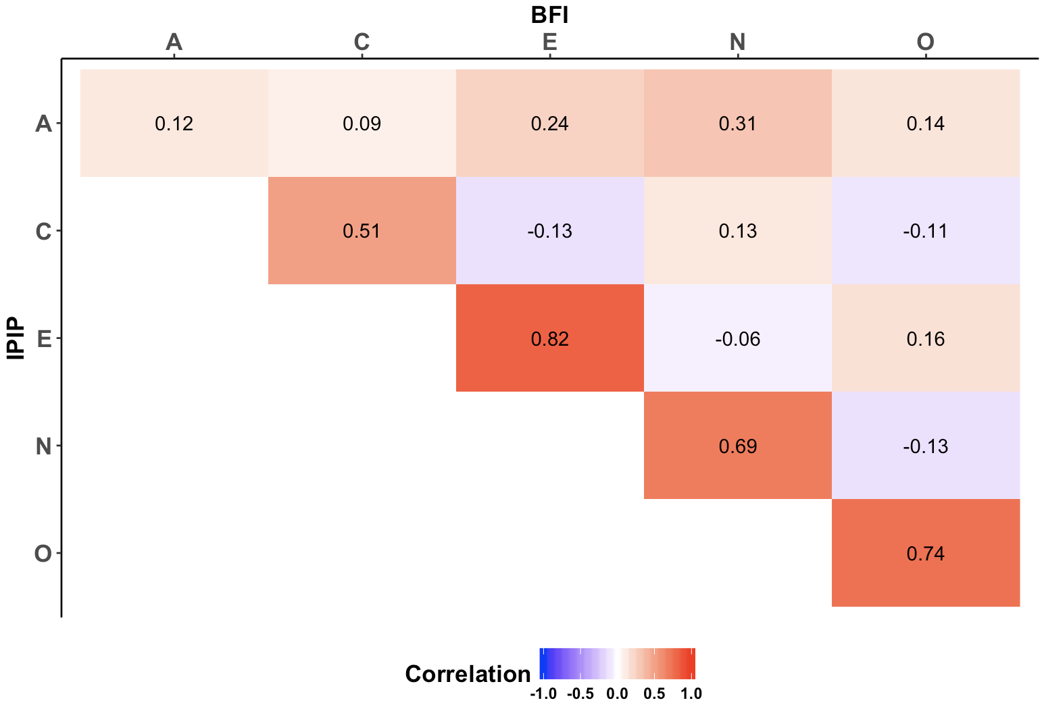
Relationship with other measures
Let’s go to JASP
Divergent validity
Our measure should not be related to other measures that assess different constructs
Scores from measures that assess different facets of personality should be different
BFI-S Conscientiousness:
I am a thorough worker.
I tend to be lazy (-)
I carry out tasks efficiently
BFI-S
Extraversion
BFI-S Conscientiousness
Notes:
Can be inter-scale (across subscales) or across measures of different constructs

Slide 41
Relationship with other measures
Let’s go to JASP
Divergent validity
Our measure should not be related to other measures that assess different constructs
Scores from measures that assess different facets of personality should be different
BFI-S Extraversion:
I am communicative.
I am sociable.
I am reserved. (-)
BFI-S
Extraversion
BFI-S Conscientiousness
BFI-S Conscientiousness:
I am a thorough worker.
I tend to be lazy (-)
I carry out tasks efficiently
Notes:
Can be inter-scale (across subscales) or across measures of different constructs

Slide 42
Relationship with other measures
Predictive validity
How does our measure predict scores on another measure assessed at a future time
Our measure of depression should predict loneliness at a future time
Subscales from the Big-5 data should predict or be related to other constructs (e.g., friendship)
GPA
BFI-S Conscientiousness
Health
Relationship Satisfaction

Slide 43
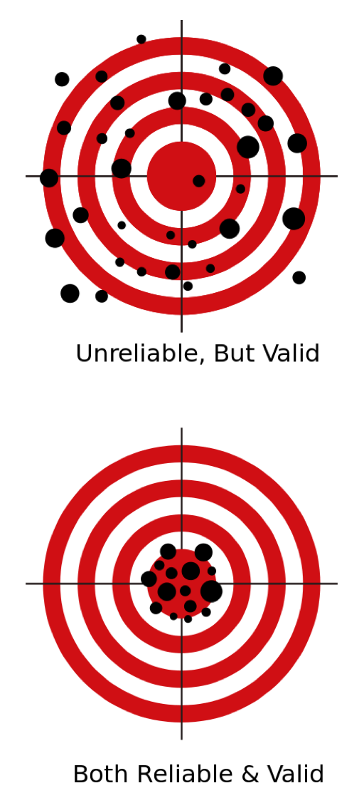
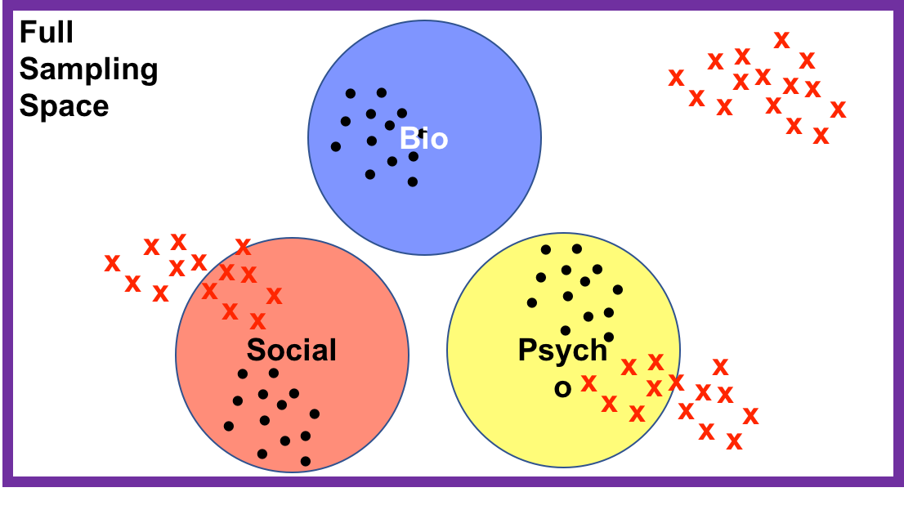
Summary
BFI Conscientiousness
Reliability: Are we measuring things well?
Internal Consistency
Validity: Are we measuring what we think we are?
Face validity
Content Validity
Concurrent Validity
Convergent Validity
Divergent Validity
Predictive Validity
BFI-S Conscientiousness
GPA
>
BFI-S
Extraversion
BFI-S Conscientiousness
BFI-S Conscientiousness
Health
Reliable
Unreliable
Relationship Satisfaction

